Slide 1


Department of BES-I
COURSE: Data Structures
COURSE CODE: 24SC1203
Name of the topic:
Double Ended Queue
Session – 20

Slide 2



AIM OF THE SESSION
To familiarize students with the basic concept of Double Ended Queue
INSTRUCTIONAL OBJECTIVES
This Session is designed to:
Demonstrate the Double ended Queue (deque)
Describe the types of deque
List out the operations possible on the deque.
Describe the each operation
List out the advantages and applications of deque.
LEARNING OUTCOMES
At the end of this session, you should be able to:
Define Double Ended Queue (deque)
Describe two types of deque. And their operations
Summarize definition, types and operations of deque and its applications

Slide 3
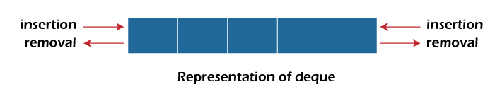
Double Ended Queue
INTRODUCTION
A double-ended queue is a linear data structure where the insertion and deletion operations are performed from both ends. It is also called as deque.
Though the insertion and deletion in a deque can be performed on both ends, it does not follow the FIFO rule. The representation of a deque is given as follows:

Slide 4
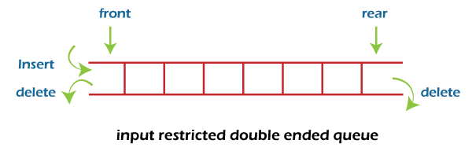
Types of Double Ended Queues
There are two types of deque:
  Input restricted queue
  Output restricted queue.
1. Input restricted Queue :
In input restricted queue, insertion operation can be performed ar only one end, while deletion can be performed from both ends.

Slide 5
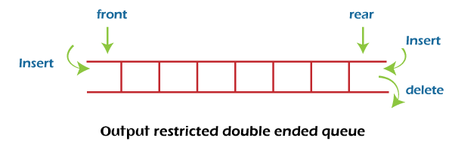
Types of Double Ended Queues Contd…
2. Output restricted Queue:
In output restricted queue, deletion operation can be performed at only one end, while insertion can be performed from both ends.

Slide 6
OPERATIONS ON DEQUE
In a double ended queue, we can perform the following operations...
  Insertion at front
  Insertion at rear
  Deletion at front
  Deletion at rear
  Display

Slide 7
OPERATIONS ON DEQUE (Cont..)
Insertion at the front end:
In this operation, the element is inserted from the front end of the queue. Before implementing the operation, first we have to check whether the queue is full or not. If the queue is not full, then the element can be inserted from the front end by using the following conditions:
  If the queue is empty, both rear and front are initialized with 0. Now, both will point to the first element.
  otherwise, check the position of the front, if the front is less than 1, then reinitialize it by front=n-1 i.e., the last index of the array.

Slide 8
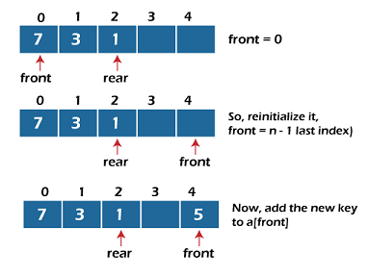
OPERATIONS ON DEQUE (Cont..)

Slide 9
OPERATIONS ON DEQUE (Cont..)
2. Insertion at the rear end:
In this operation, the element is inserted from the rear end of the queue. Before implementing the operation, first we have to check whether the queue is full or not. If the queue is not full, then the element can be inserted from the rear end by using the below conditions:
If the queue is empty, both rear and front are initialized with 0. Now, both will point to the first element.
Otherwise, increment the rear by 1. If the rear is at last index ( or size -1), then instead of increasing it by 1, we have to make it equal to 0.

Slide 10
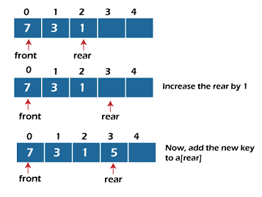
OPERATIONS ON DEQUE (Cont..)

Slide 11
OPERATIONS ON DEQUE (Cont..)
3. Deletion at the front end:
In this operation, the element is deleted from the front end of the queue. Before implementing the operation, we first check whether the queue is empty or not.
If the queue is empty i.e., front = -1, it is the underflow condition, and we cannot perform the deletion. If the queue is not full, then the element an be inserted from the front end by using the below conditions:
If the deque has only one element, set rear = -1 and front = -1
else, if front is at end (that means front = size – 1) set front = 0’
else, increment the front by 1. (i.e., front = front + 1)

Slide 12
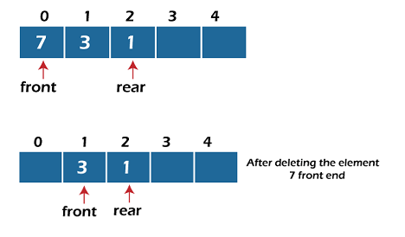
OPERATIONS ON DEQUE (Cont..)

Slide 13
OPERATIONS ON DEQUE (Cont..)
4. Deletion at the rear end:
In this operation, the element is deleted from the rear end of the queue. Before implementing the queue operation, we first check the queue is empty or not.
If the queue is empty, i.e., front = -1, it is the underflow condition, and we can’t perform the deletion.
If the deque has only one element, set rear = -1 and front = -1.
If rear = 0 (rear is at front), then set rear = n-1.
else, decrement the rear by 1 (or rear = rear – 1)

Slide 14
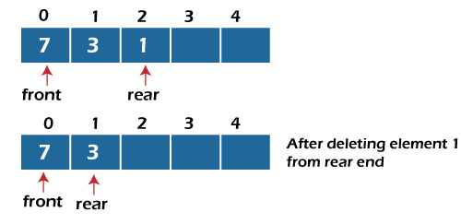
OPERATIONS ON DEQUE (Cont..)

Slide 15
OPERATIONS ON DEQUE (Cont..)
Algorithm: insert_front(int x)
{
if((f==0 && r==size-1) || (f==r+1))
{
printf("Overflow");
}
else if((f==-1) && (r==-1))
{
f=r=0;
deque[f]=x;
}
else if(f==0)
12. {
13. f=size-1;
14. deque[f]=x;
15. }
16. else
17. {
18. f=f-1;
19. deque[f]=x;
20. }
21. }

Slide 16
OPERATIONS ON DEQUE (Cont..)
Algorithm: insert_rear(int x)
{
if((f==0 && r==size-1) || (f==r+1))
{
printf("Overflow");
}
else if((f==-1) && (r==-1))
{
r=0;
deque[r]=x;
}
else if(r==size-1)
12. {
13. r=0;
14. deque[r]=x;
15. }
16. else
17. {
18. r++;
19. deque[r]=x;
20. }
21}

Slide 17
OPERATIONS ON DEQUE (Cont..)
Algorithm: delete_front()
{
if((f==-1) && (r==-1))
{
printf("Deque is empty");
}
else if(f==r)
{
printf("\nThe deleted element is %d", deque[f]);
f=-1;
r=-1;
}
12. else if(f==(size-1))
13. {
14. printf("\nThe deleted element is %d", deque[f]);
15. f=0;
16. }
17. else
18. {
19. printf("\nThe deleted element is %d", deque[f]);
20. f=f+1;
21. }
22. }

Slide 18
OPERATIONS ON DEQUE (Cont..)
Algorithm: delete_rear()
{
if((f==-1) && (r==-1))
{
printf("Deque is empty");
}
else if(f==r)
{
printf("\nThe deleted element is %d", deque[f]);
f=-1;
r=-1;
}
12. else if(r==0)
13. {
14. printf("\nThe deleted element is %d", deque[r]);
15. r=size-1;
16. }
17. else
18. {
19. printf("\nThe deleted element is %d", deque[r]);
20. r=r-1;
21. }
22. }

Slide 19
APPLICATIONS OF Deque
Deque can be used as both stack and queue, as it support both operations.
Deque can be used as a palindrome checker means that if we read the string from both ends, the string would be the same.

Slide 20
SUMMARY
Double ended Queue is a linear data structure, where the insertion and deletion operations are performed from both ends. It is also called as deque.
In deque, there are two types...
i) Input restricted queue
ii) output restricted queue
In input restricted queue the following operations are performed:
i) Inserting At Beginning
ii) Inserting At End
In output restricted queue, the following operations are performed:
i) Deleting from Beginning
ii) Deleting from End

Slide 21
SELF-ASSESSMENT QUESTIONS
Which of the following application makes use of a deque?
a) Checks palindrome
b) Insert an element
c) Delete an element
d) All the above
2. Which of the following is true to check deque is full or not?
a) front = rear + 1
b) Front = rear
c) front=0
d) rear=-1

Slide 22
TERMINAL QUESTIONS
1. Describe About double ended queue?
2. List out different types of deque?
3. List out different operations can perform on deque?
4. Analyze the time complexity of the deque for the operations such as insertion, deletion.

Slide 23
REFERENCES FOR FURTHER LEARNING OF THE SESSION
Reference Books:
  Mark Allen Weiss, Data Structures and Algorithm Analysis in C, 2010 , Second Edition, PearsonEducation.
  2. Ellis Horowitz, Fundamentals of Data Structures in C: Second Edition, 2015
  A.V.Aho, J. E. Hopcroft, and J. D. Ullman, “Data Structures And Algorithms”, Pearson Education, First Edition Reprint2003.
Sites and Web links:
1. https://nptel.ac.in/courses/106102064
2. https://in.udacity.com/course/intro-to-algorithms--cs215
3. https://www.coursera.org/learn/data-structures?action=enroll

Slide 24
THANK YOU
Team – Data Structure

